Slide 1

Best Practices for Aging-Out Youth
Advanced Family Law
August 5, 2014
MARY CHRISTINE REED
Attorney/ Project Director
Texas Foster Youth Justice Project
Texas RioGrande Legal Aid, Inc.
JUDGE CHARLES VAN ORDEN
Associate Judge
Cen Tex Child Protection Court
Notes:
Announce plan to stop at 30 minutes for questions. 5 minutes at end for summary.

Slide 2
Texas Foster Youth Justice Project
Hotline 1-877-313-3688
Email: info@texasfosteryouth.org
www.texasfosteryouth.org
Provides FREE:
  Advice, legal assistance, and representation to current and former foster youth for a range of issues related to foster care and transitioning to independence
  Resources and guidance for AALs, GALS, CASAs and others
  A Guide to “Aging Out” of Foster Care in Texas
Notes:
MCR brief discussion of project and services provided, availability of guides

Slide 3
Cen-Tex Child Protection Court
Bell, Llano, and Burnet Counties
Philosophy of court regarding older youth
Judge Charles Van Orden
  1-254-933-5386 (Office)
  1-254-718-6514 (Cell)
  Email: judgecvo@justice.com
Notes:
CVO discuss

Slide 4

Youth Participation in Court
Notes:
CVO structure of the youth participation in his court.
MCR Beyond the legal requirements, importance to youth, opportunity to have meaningful review and accountability of case and transitional planning.

Slide 5

Video Conferencing
Notes:
CVO discuss how it works

Slide 6
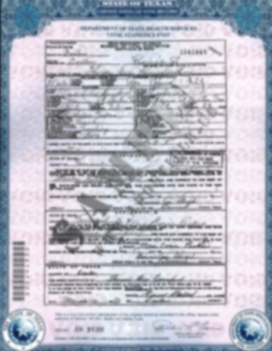
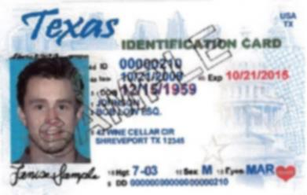
Identification Documents
Receive by age 16, all in the same, correct name:
  Birth Certificate
  Social Security Card
  Texas Identification Card or Driver’s License
  Immigration Document or Certificate of Citizenship if not U.S. born
Assess Name Change/Fixing Needed
Notes:
MCR why so important to make sure this is done

Slide 7

Role of Attorney Ad Litem
Notes:
MCR – statutory requirements regarding meeting with client, review of education, health and medication, advocating for the youth, CVO – Knowing what is happening with youth and power of the AAL

Slide 8
Issues Important to Youth
Over medication
Relative/caring friend placement
Contact/ reunification with biological family
Participation in school and friend activities
Being a “normal” teen
Having a voice
Answers, explanations- No CPS limbo!
Notes:
CVO discuss how he addresses these issues

Slide 9
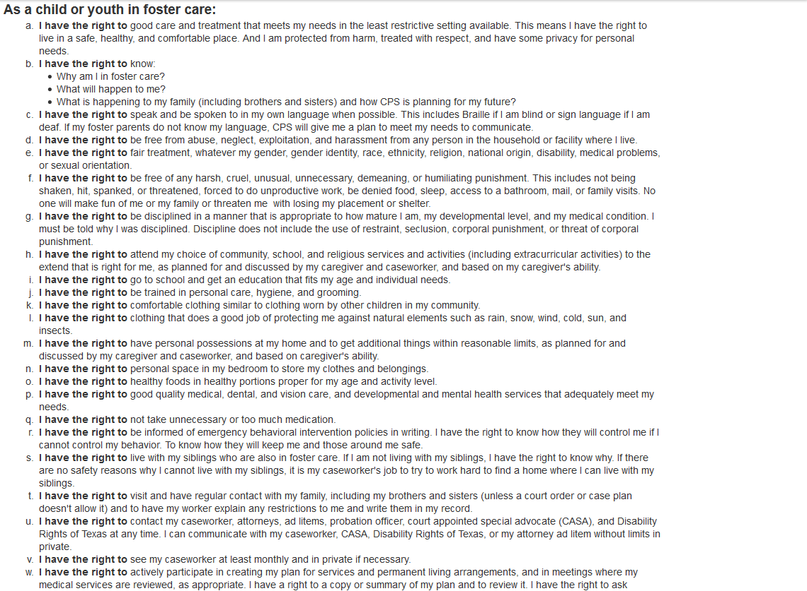
Rights of Children and Youth in Foster Care
Notes:
CVO and MCR have copies of all rights. Discuss a right or two. Leads in to Consent to Medical care slide.

Slide 10
Consent to Medical Care by Foster Youth
Foster youth 16 or 17 can be given rights by the court to consent to all or some medical care.
DFPS must inform youth of this possibility before the youth turns 16 and AAL must advise youth 16 and older about the right to request this.
Youth named consenter must complete the CPS training.
TX Fam. Code §266.010.
Critical for helping youth prepare to handle medical care post age 18.
Notes:
MCR overview of law and importance

Slide 11
Medicaid for Aged Out Foster Youth Until Age 26!
“Former Foster Care Children’s Program”
Apply same ways apply for other public benefits such as food stamps, TANF and other Medicaid programs- yourtexasbenefits.com
Can get additional information and help at: texasfosteryouth.org
Many former foster youth are not aware of this new program
Notes:
MCR brief overview

Slide 12
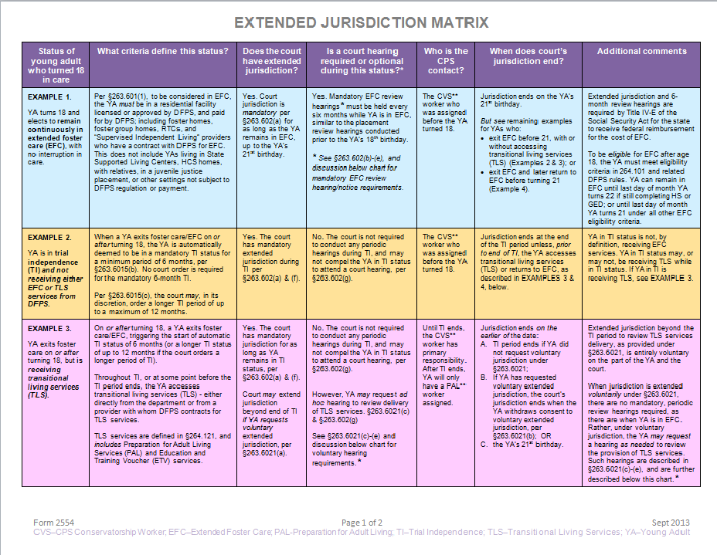
Extended Jurisdiction Matrix
Notes:
MCR – developed to help all parties in court proceedings understand what happens once youth turns 18 – importance of requesting 12 month trial independence and extension of jurisdiction until age 21

Slide 13
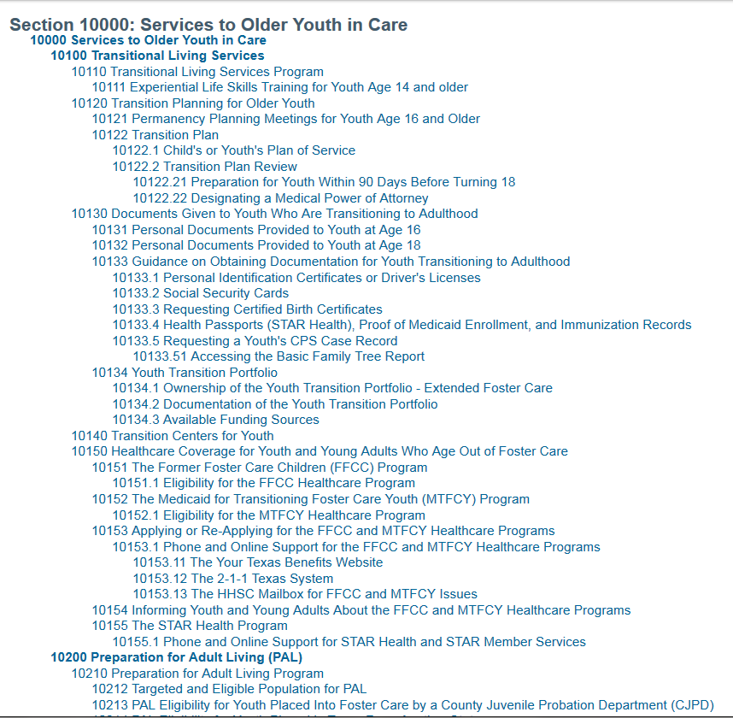
CPS Handbook Section 10000
Services to Older Youth in Care
Notes:
MCR guidance regarding older youth updated. Great resource for finding out what should be happening when and compeling CPS to follow their own policies and procedures.

Slide 14
Utilize CPS Specialists and Follow Up Directly with Them
Caseworker and supervisor should be able to tell you who the regional specialist is but if not, here are some contacts:
SSI Specialist
  Office of Consumer Affairs- www.dfps.state.tx.us/Contact_Us/Inquiries_and_Complaints
Immigration Specialist-
  State Office- Carol Self: 512-438-3589; Carol.Self@dfps.state.tx.us
Developmental Disability Specialist
  State Office- Bridget Crawford: 512-438-5421; Bridget.Crawford@dfps.state.tx.us
Education Specialist
  State Office- Kristine Mohajer: 512-438-3148; Kristine.Mohajer@dfps.state.tx.us
Notes:
Can call TFYJP for assistance in identifying

Slide 15
Youth with Disabilities
Start planning at 14
Request HCS slot upon entering care
Guidance in CPS Handbook
Bring in the Specialists
  Developmental Disability
  Education
  SSI
Notes:
CVO – Appointing Disability Rights Texas, MCR AAL moving planning process along

Slide 16
Sibling Contact After Aging Out
Try to arrange through caseworker of siblings still in care
CASA and AAL as resource
Adult sibling can bring suit for access to a child when separated by action taken by DFPS (Tex. Fam. Code §153.551)
Texas Foster Youth Justice Project can provide representation
Notes:
MCR – when sibling is in CPS care, issue is generally locating caseworker and navigating the communications- third party placement can require litigation –statute is very broad

